Slide 1
Keele Management School
KNOWLEDGE SHARING AND SOCIAL NETWORKS
Harry Scarbrough

Slide 2


Traditional linear model
KNOWLEDGE TRANSFER
knowledge users
knowledge producers

Slide 3
What is knowledge translation?
Making the knowledge produced by one group meaningful to, and applicable by, another group.
transfer
VS.
translation

Slide 4
Why is the translation of knowledge difficult?
Knowledge is embedded in the social practices of particular groups – ‘communities of practice’
Knowledge is shared within social networks and translation across boundaries is difficult
Professional communities institutionalize different ‘ways of knowing’ – represent different ‘epistemic communities’

Slide 5
Analysing ‘communities of practice’
Community of practice “An activity system about which participants share understandings concerning what they are doing and what it means in their lives and for their community” (Lave & Wenger, 1991)
Spontaneous
not necessarily linked to formal roles/structures but emerge as people deal with problems
Based on shared meanings & identity
Knowledge is acquired through apprenticeship – involves becoming a practitioner not copying the practice

Slide 6



Skateboarding as a community of practice
+
+

Slide 7
Knowledge, community and practice
Community of practice challenges the view that knowledge is an object that can be transferred from one place to another
Knowledge used in practice comes from learning-by-doing in particular contexts
People learn by working with others – they learn not only the practice but to be a practitioner
Shared practice creates and is sustained by informal communities

Slide 8
Social Network Analysis
Social structure where individuals represented as NODES and their relationships as TIES
Notes:
More than just connections: - Has to say something about what is effectives within the context of what the CLAHRCs are trying to achieve.
(Zaheer et al, 2010) i.e. The network perspective itself does not constitute a theoretical lens. Network ties can encompass virtually any kind of association between social actors and organisations. But all it says is that at the most fundamental level – structure matters.
A great social connection (e.g. Going down to the pub), may suggest that a great social network is formed, but for our study, we need to be able to say more than this, and ask whether the good social ties are also supporting the knowledge facilitation aspirations of the CLAHRC initiative. This is where by using a theory-based evaluation, we can support more meaningful analysis of the network.

Slide 9


Strong ties
- family members, close friends, work colleagues
Support collaboration enabling the sharing and embedding of knowledge.
Limit access to novel information and knowledge because people tend to interact with people like themselves (homophily).
‘social circles’

Slide 10
Weak ties
– diverse acquaintances, contacts etc - enable the exchange of new ideas, information and knowledge across the boundaries of different social groups (brokering)
A
Z
A
Z
A
Z

Slide 11


Knowledge translation
Exchanging or creating new knowledge or evidence involves weak ties between groups
Embedding knowledge or evidence involves strong ties within cohesive groups
Notes:
Multiple network structures are required for innovation capabilities to develop.
Brokerage (for exchanging novel ideas across boundaries) and closure (to embed
knowledge and allow effective implementation).
Closure for implementation of knowledge
Closure based on high network density, strong ties , trust, stability, norms & homogeneity (Coleman, 1988, 1990). These ties support knowledge translation (West et al, 1999). Bonding social capital as horizontal between peers.
Brokering for idea generation
Structural holes -Non-redundant relations = opportunities for accessing novel information (Granovetter, 1973; Burt, 1992, 2000). In health research = heterogeneity/diversification of information sources , epistemologies & practices conceptualised as ‘boundary spanning’ or ‘linkage’ (Lomas, 2000; 2007).
In organisational research, recognition that different types of ties & knowledge emerge in different network settings . Tacit/complex information (Nonaka, 1994; Hansen, 1999), communities of practice (Lave &Wenger, 1991), epistemic cultures (Haas, 1992; Knorr-Cetina, 1999).
Bridging social capital as horizontal (Granovetter, 1973; Putnam, 2000) i.e. between work-groups.
Linking social capital as vertical (Woolcock, 2001) i.e. between people located at different network positions or across levels of management hierarchy.

Slide 12
Collaborations for Leadership in Applied Health Research & Care (CLAHRCs)
9 CLAHRCs: Regional collaborations between universities, NHS (Primary care trusts, Acute care trusts and mental health trusts) & other stakeholder groups within local health community
Funded for 5 years by the NIHR (£3m each plus matched funding)
Focus on bridging the 2nd translational gap
Develop innovative models for conducting applied health and translating findings into improved outcomes for patients
CLAHRCs are all very different

Slide 13
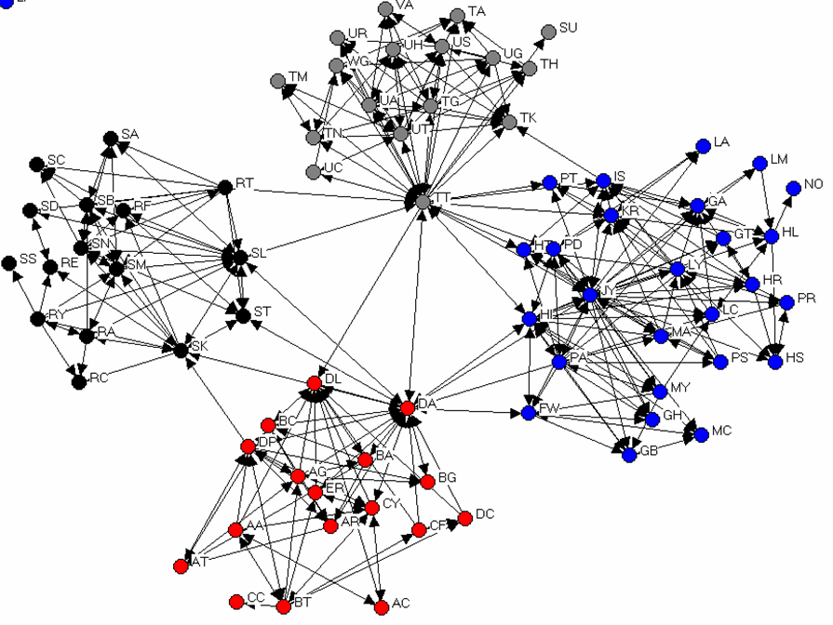
CLAHRC initiative in the NHS
Clinical researchers
Social scientist researchers
Hospital doctors
Allied health practitioners

Slide 14
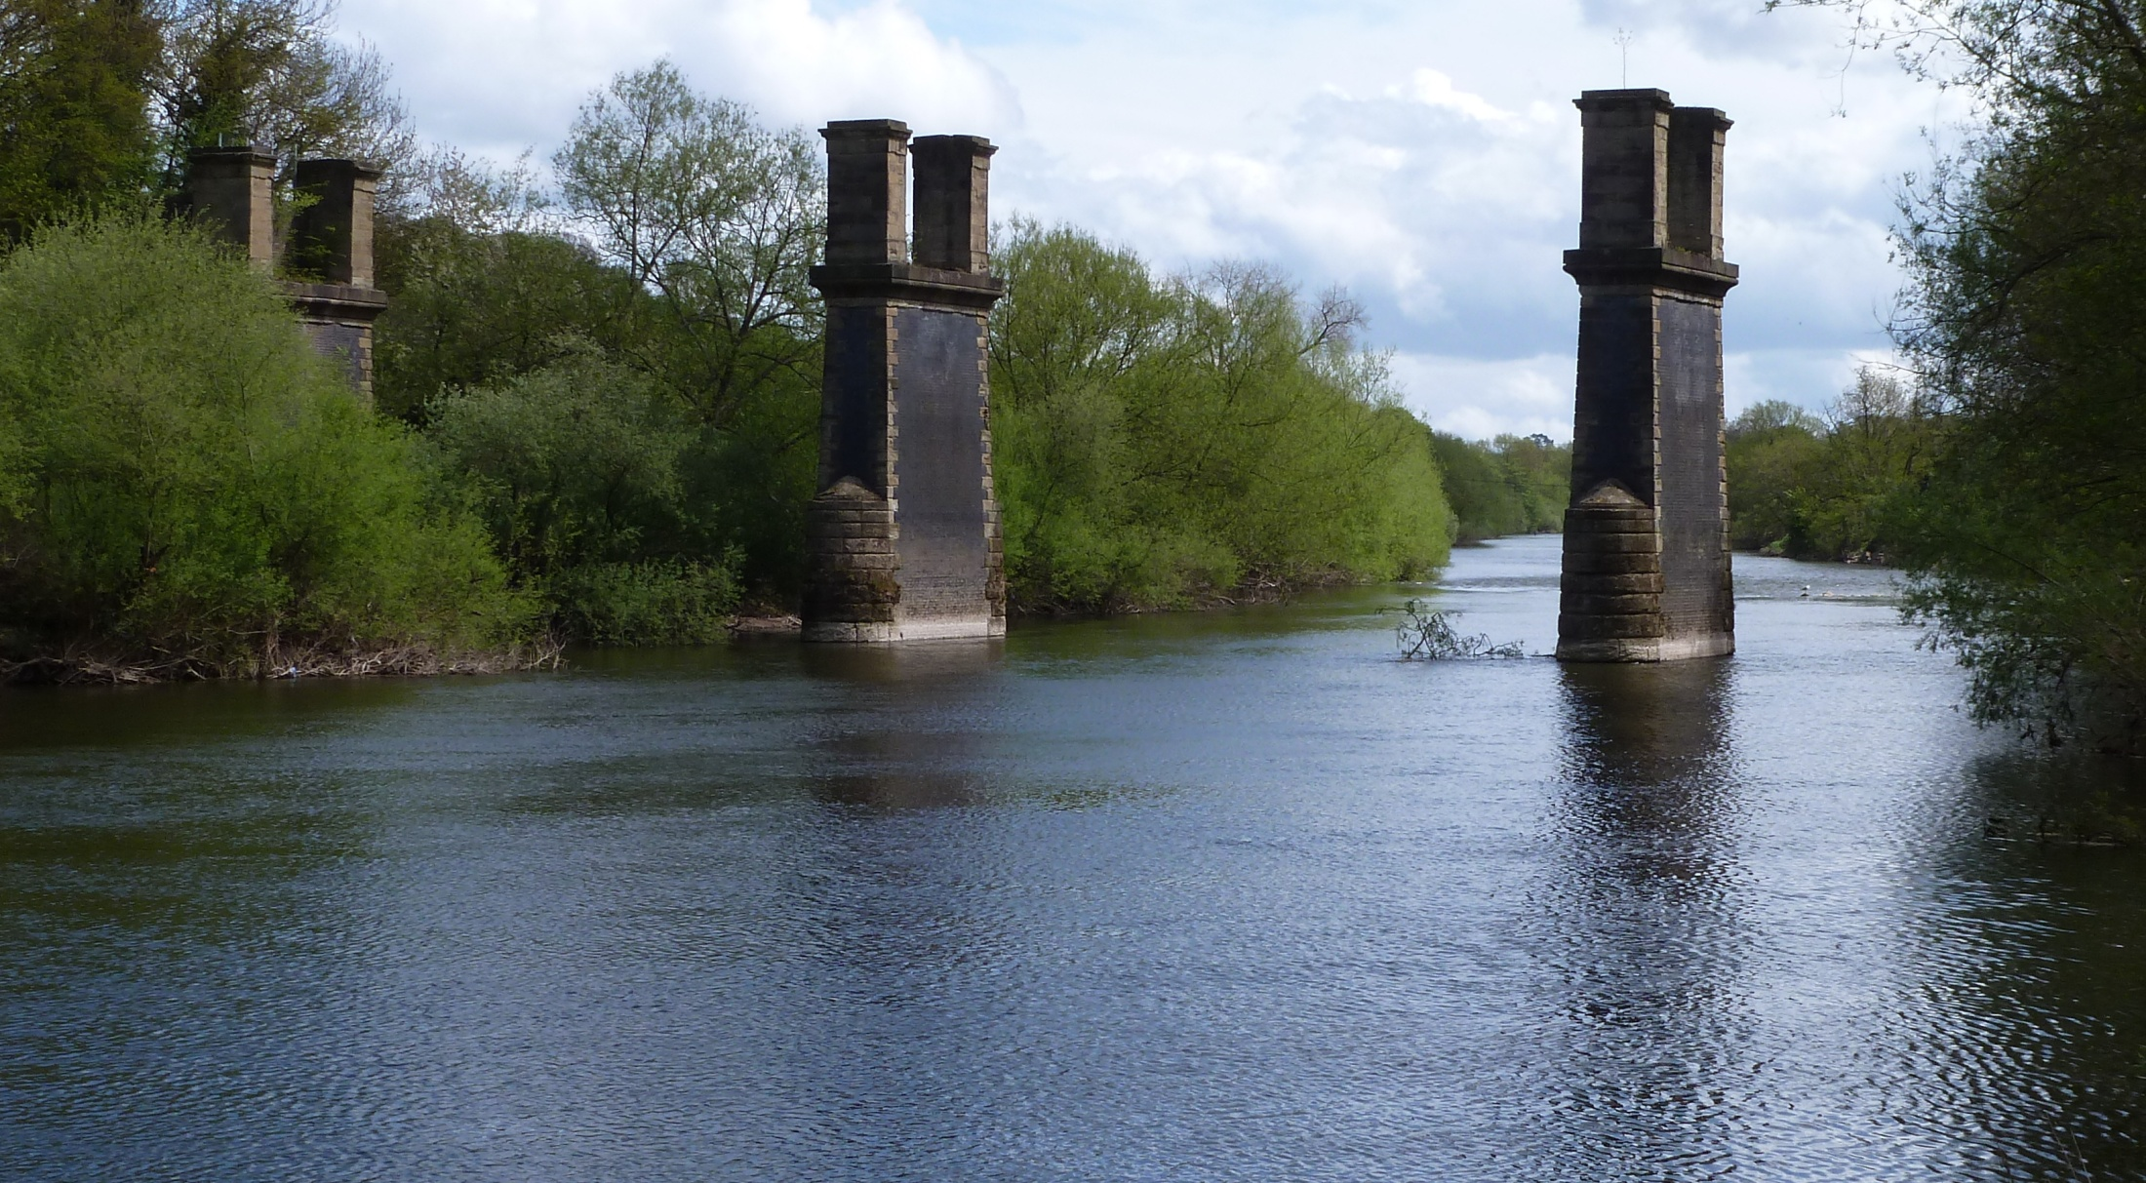
Bridging the Gap?

Slide 15
Knowledge translation initiative in the NHS
Clinical researchers
Social scientist researchers
Hospital doctors
KNOWLEDGE BROKERS
Allied health practitioners

Slide 16
Knowledge translation – role of brokers

Slide 17
Conclusions
Knowledge translation is a social process – not reducible to sharing information
Depends on building social networks – brokers play a key role in bridging the between groups
Translation is also challenged by differences in practice – involves collaborating across communities of practice
Different ‘ways of knowing’ pose a challenge for collaboration across professional communities

Slide 18
Thank you

